Slide 1
Stock Market Predictor
QHacks 2019
Tingkai Zhang, Srishti Sehgal, Ashley Wang

Slide 2

CRISP-DM
CRoss-Industry Standard Process
for Data Mining
Business understanding
Data understanding
Data preparation
Modeling
Evaluation
Deployment

Slide 3
Step 1: Business Understanding
Which model can we use to predict the future trend of a stock?

Slide 4
Step 2: Data Understanding
Data Acquisition
Notes:
The data understanding phase starts with an initial data collection and proceeds with activities in order to get familiar with the data, to identify data quality problems, to discover first insights into the data, or to detect interesting subsets to form hypotheses for hidden information.

Slide 5
Step 3: Data Preparation
Data Cleaning & Shaping
Parsing of text (4 points)
Removed irrelevant columns from data frame
Returns
Volume
Time of day
Notes:
The data preparation phase covers all activities to construct the final dataset (data that will be fed into the modeling tool(s)) from the initial raw data. Data preparation tasks are likely to be performed multiple times, and not in any prescribed order. Tasks include table, record, and attribute selection as well as transformation and cleaning of data for modeling tools.

Slide 6
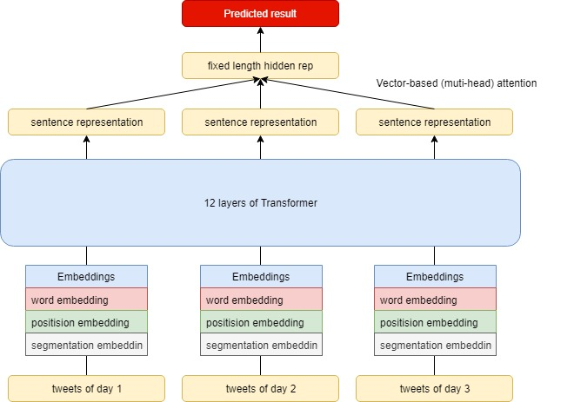
Step 4: Modeling
After the data understanding and data preparation steps, the features
of the data are:
Date, Name, Past1, Past2, Past3, Label
Bert + Attention
GPT + Average Pooling
Transfer learning

Slide 7
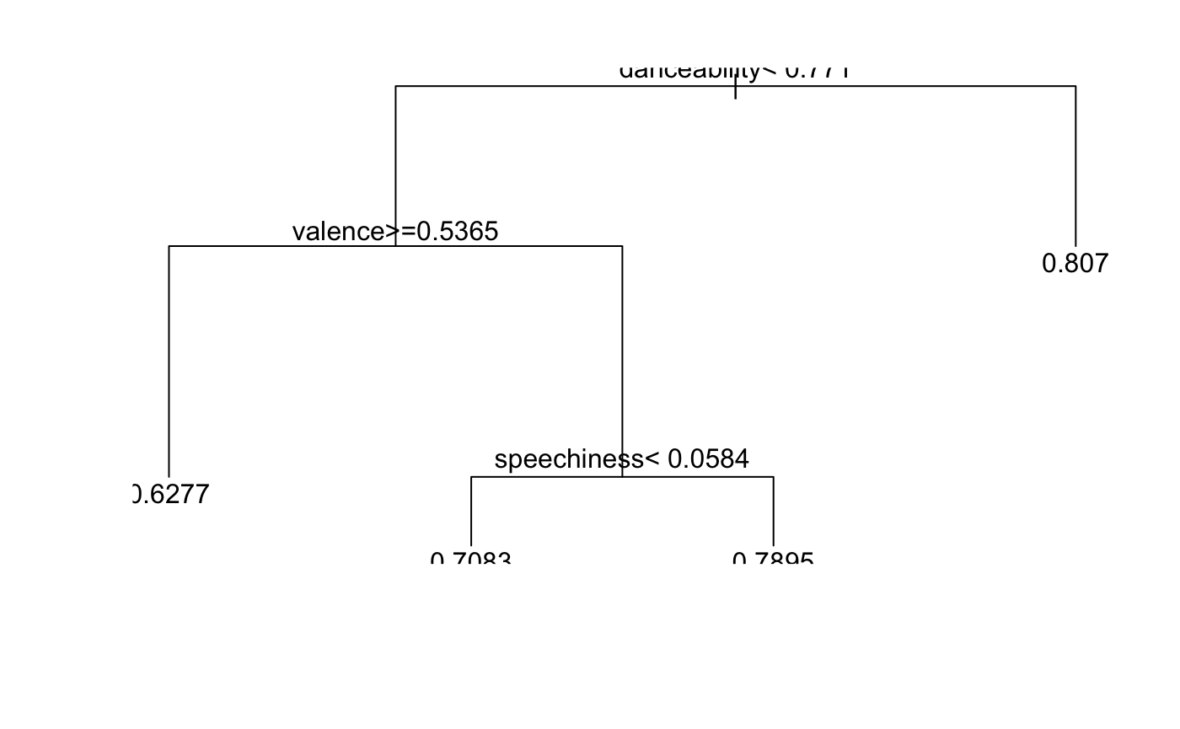
Step 4: Modeling
Model Construction & Evaluation

Slide 8
Step 5: Evaluation

Slide 9
Step 6: Deployment
This presentation.
For future work, this project could use:
More prediction models
Larger data set
Further data exploration

Slide 10
Project available on Github

